Slide 1
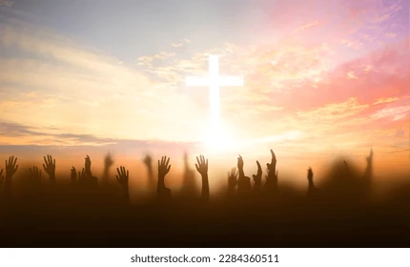
Mat. 12:21, Mat. 1:23
Sis. Liezel Gilva
A NAME THAT
BRINGS HOPE

Slide 2

MATTHEW 12:21
“Narito ang lingkod ko na aking hinirang,
ang aking minamahal at lubos na kinalulugdan; ibubuhos ko sa kanya ang
aking Espiritu, at siya ang magpapaira ng katarungan sa mga bansa.

Slide 3
MATTHEW 1:23
“Maglilihi ang isang birhen at magsisilang ng isang sanggol na lalaki, at tatawagin itong Emmanuel”

Slide 4
I. JOY
Is a supernatural fruit of the holy spirit that provides strength, peace and encourage even in difficult times.

Slide 5
II. EMPOWERMENT
Spirit transformation enabling believers to live victoriously over sin, fulfill God’s purpose and serve others through the indwelling holy spirit giving strength, purpose and confidence to do greater things.

Slide 6
III. SATISFACTION
Finding fulfillment, purpose and contentment in Him, not wordly things, but through a deep personal relationship with God where he satisfies the the souls deepest longings for love, peace and even in the midst of life difficulties.

Slide 7
- Come to Him
- Feed on Him
- Listen
- Trust his sufficient
- Delight in the Lord

Slide 8
IV. UNITY
A state of being united or joined
as a whole.

Slide 9
V. Salvation
In our condition as sinners we are spiritually helpless in the sight of God.
We cannot save ourselves, only Jesus can save ourselves, can deliver from the penalty, the damnation of sin.

Slide 10
Conclusion:
Jesus is the fulfillment of God for us for the remission of our sins.

